Slide 1
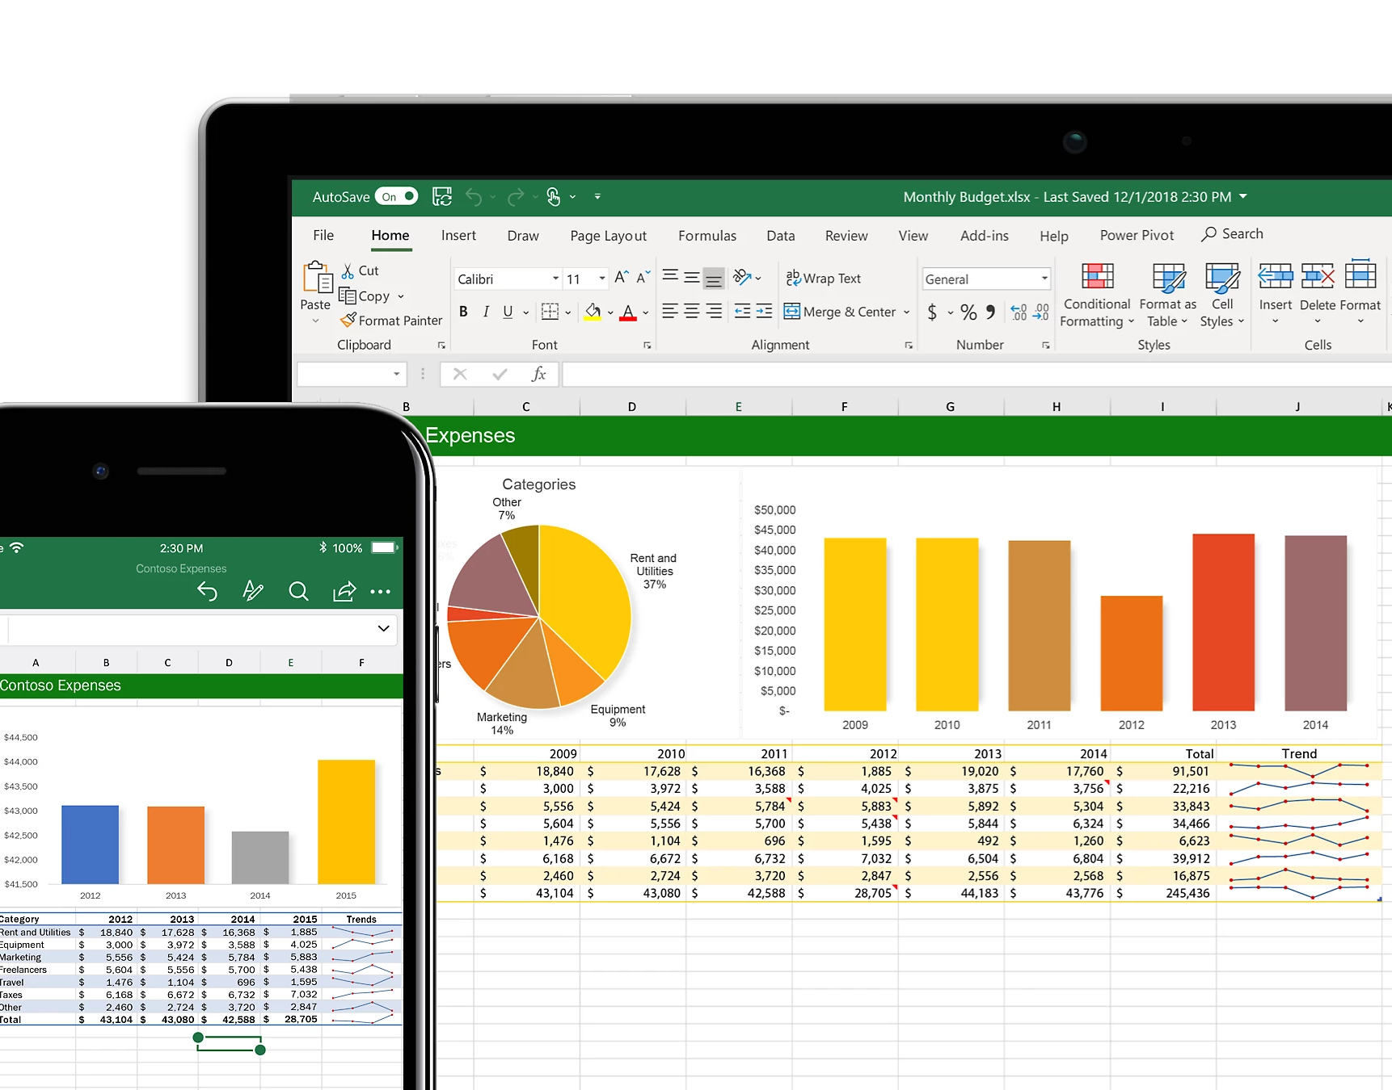
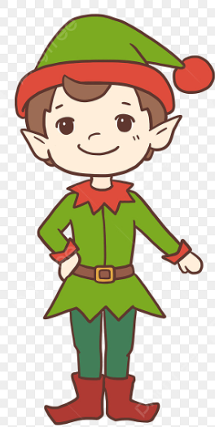
Elf Morning
Tracker
Instructions
Author:
Mike Kinnavy
April 22, 2023

Slide 2
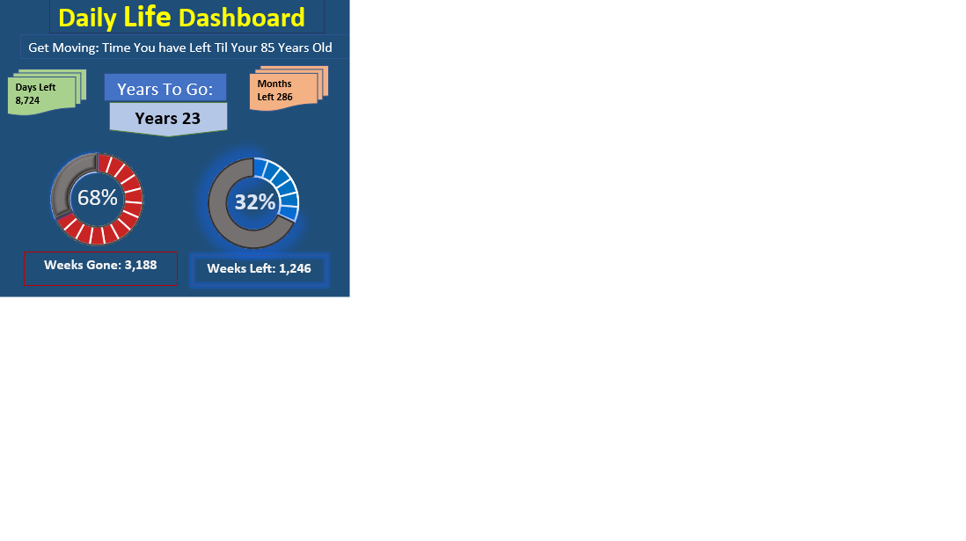
1) Open the spreadsheet on a desktop computer:
press the “View” button.

Slide 3
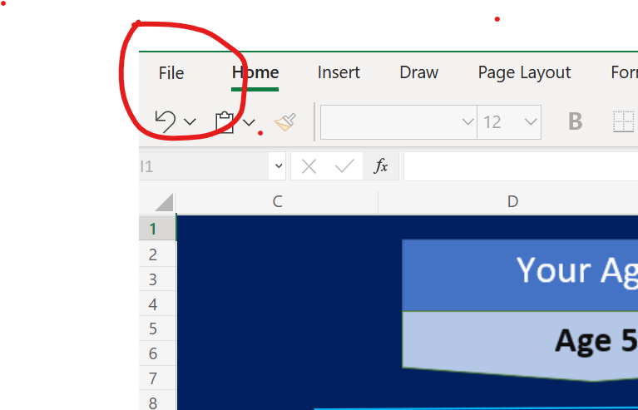
2) Then save a copy of the spreadsheet on your computer.

Slide 4
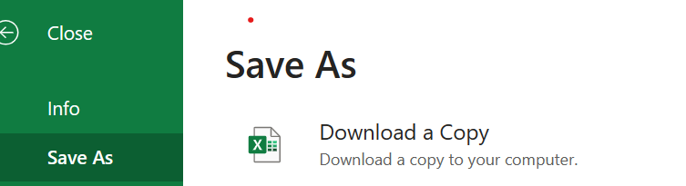
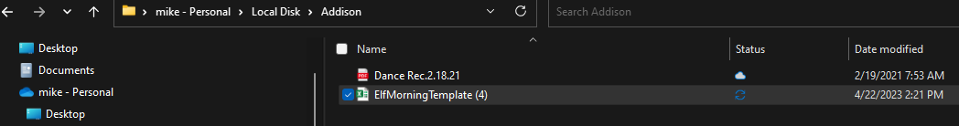
3) Save As – Download a copy on your Desktop computer.
Example: Addison folder name: ElfMorningTemplate(4):

Slide 5
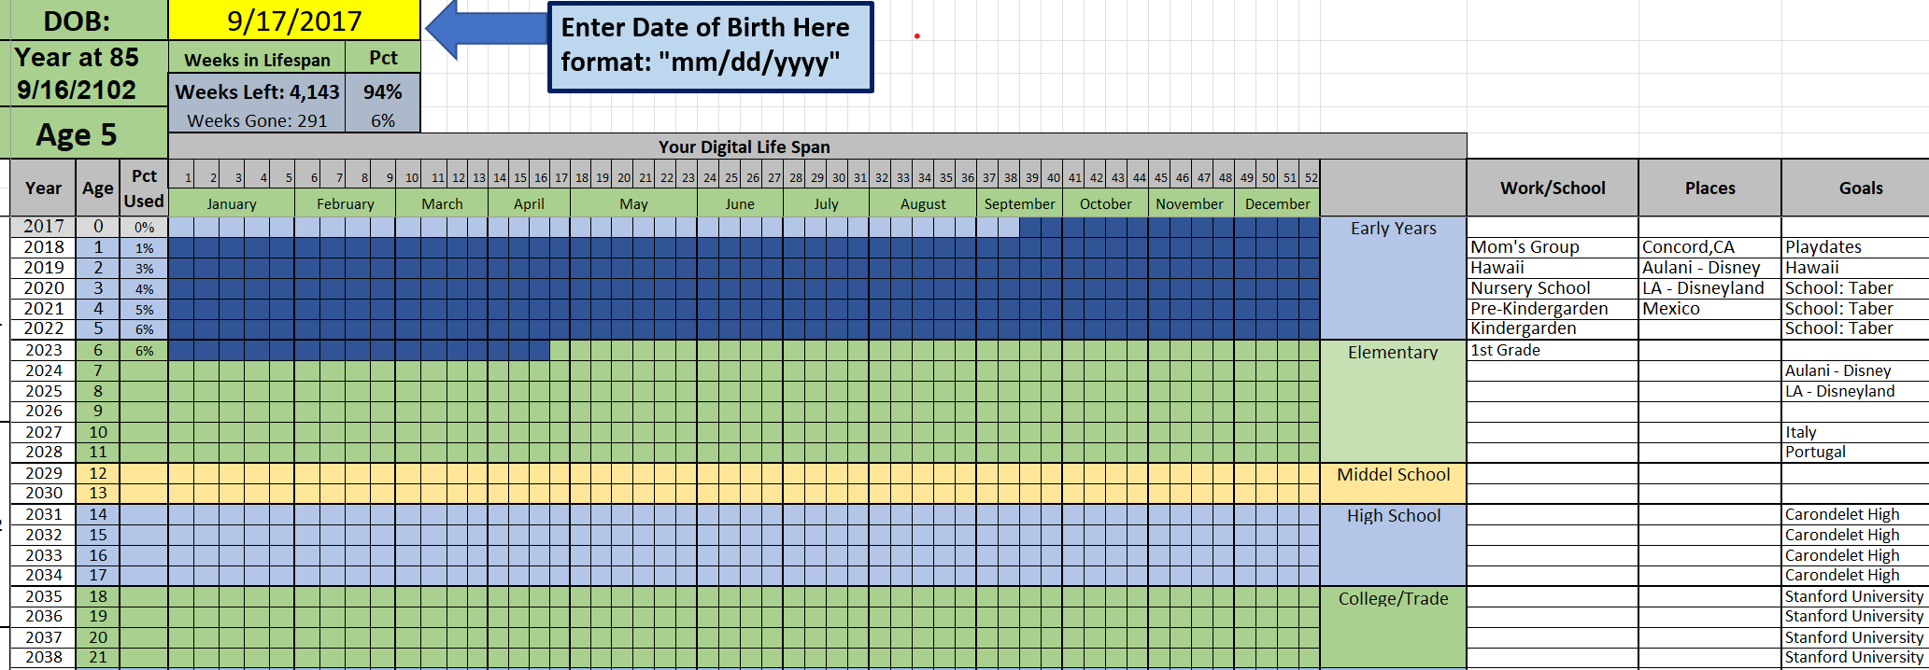
4) Open up Spreadsheet and “Enter Date of Birth:”

Slide 6
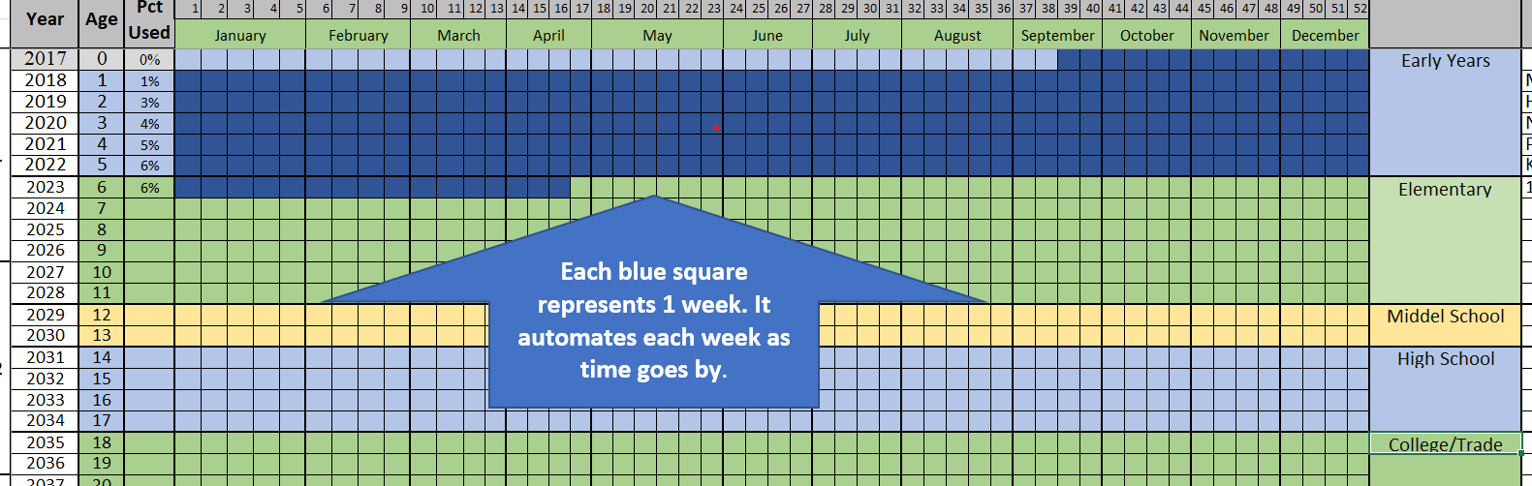
5) Each Blue square represents 1 single week in your life that has already passed:

Slide 7
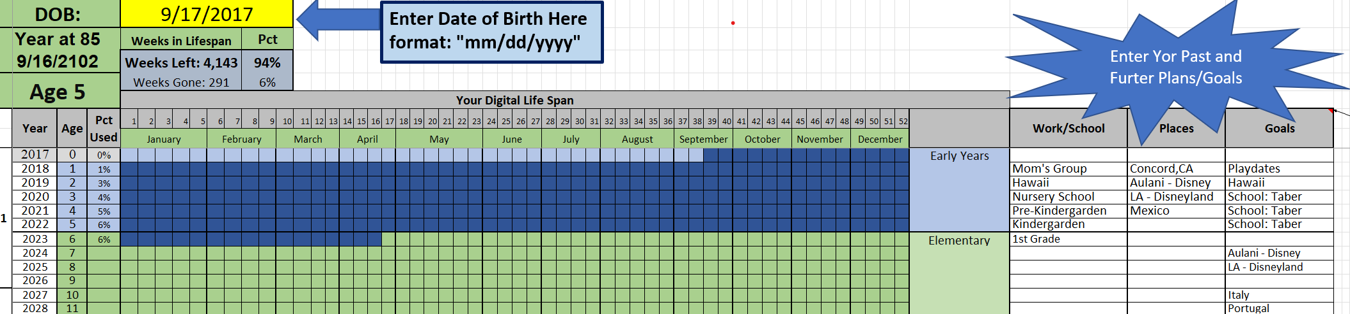
6) The far right you can enter where you have worked/schools, Places you have visited or lived at and Goals to reach (past, present and future – future schools, Places to go and Goals to reach.
Example below:

Slide 8
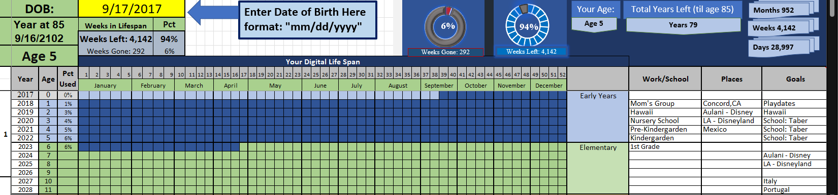
7) Status report.
It will show your Age and Total years left (up to age 85) and weeks and percentages that have already gone by and how much time you have left. Do you daily habits to help along the way to keep active physically and mentally.

Slide 9
The Other “Morning Elf Tracker” slides show additional information on how to use the “Daily Elf Tracker” and for your convenience it also has simple little maintenance to keep your tracker up to date by yourself.
Using the Daily Tracker slides

Slide 10

Intro to Morning Habits:
This is based on the book on Elf Morning Routine book.
Track Your Morning Tasks in Daily tab and get an average time and track that on Excel tab “Daily”.
Use the Daily tab drop-down list and times. Center point is time you get up or just below “Time Out,”
.

Slide 11


Digital Life Span (how much time you have left till age 85).
1) Just Enter your date of birth (highlighted Yellow)
2) Will show how much time you have used up in your life, showing weeks that have already been used and the number of weeks left till you reach 85 years of age.
3) Auto-calculates each week that goes by (highlight blue).
Enter where you’ve been and Future Goals here

Slide 12
Digital Life Span (Dashboard):
1) Shows your current age (example 5 years old)
2) Shows Total Years Left (till age 85)
3) Age 85, if we make it that long, it’s the age to reach for.

Slide 13
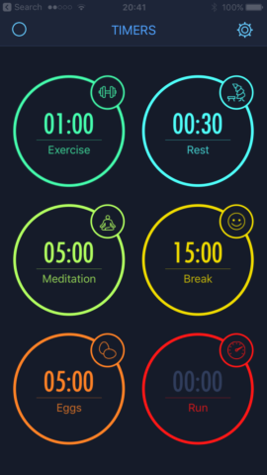
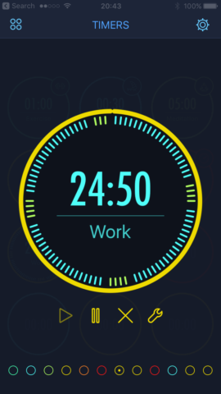
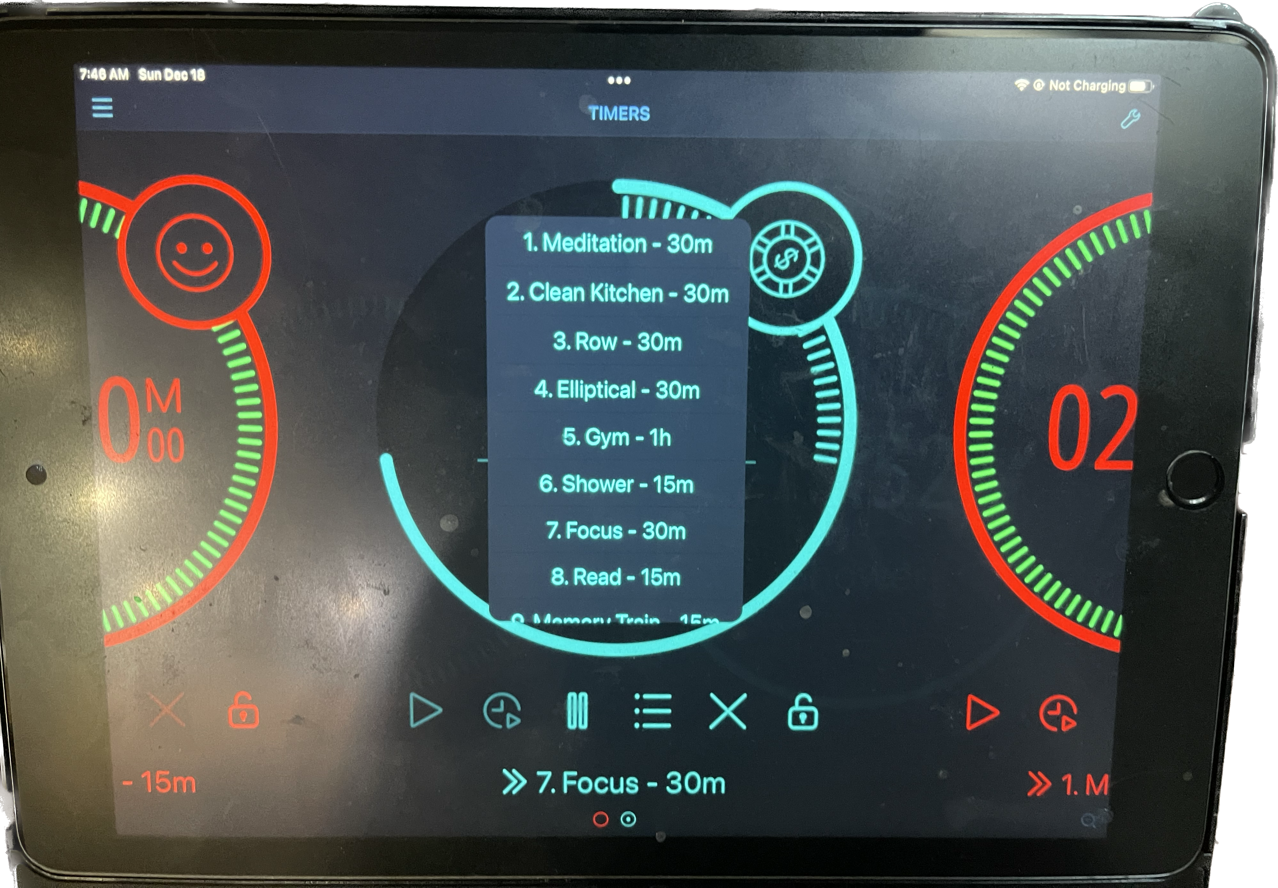
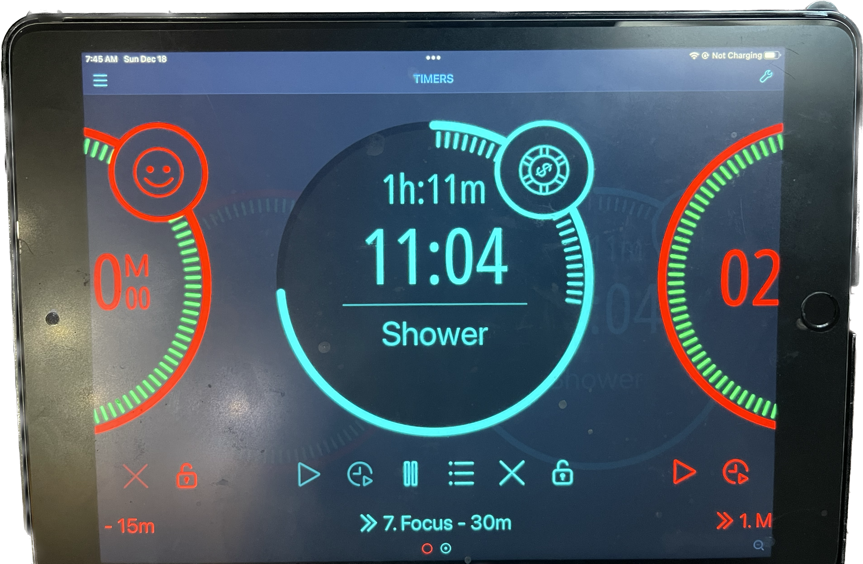
Get up Early and focus on your daily tasks and times
1) Use Timers preferably an Interval Timer works best.
2) I use the IPAD Multi-Timer PRO Application

Slide 14

Daily - Track time to go to bed and time you get up (drop down for Tasks and Times-Starts with Bed “Time Out” aka: wake up)
Trigger Time

Slide 15
Daily Tab: 1 Week (7/10 Days to Track) – Once a week take one day not used and copy it from Bed to Total Internet for each new week.

Slide 16
Daily Data: Automatically goes to Raw Data tab – Drives the Dashboard tab (gray tabs only: Formulas)

Slide 17
Once a Week: Copy Gray data to paste values to rows above. Leave Gray area (formulas)
Paste
Here
Copy

Slide 18
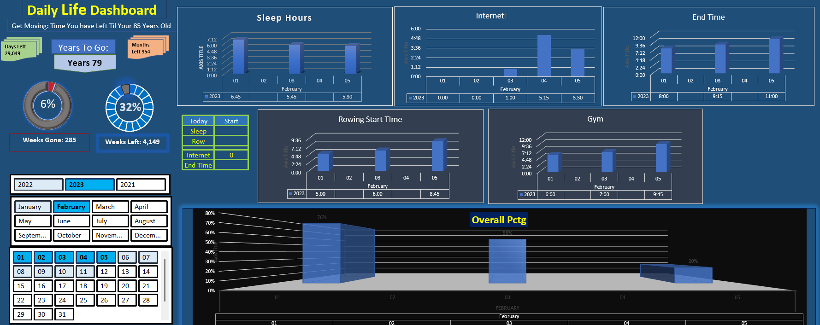

Dashboard Totals
In Excel: Daily Life Dashboard & Groundhog Daily Habits

Slide 19
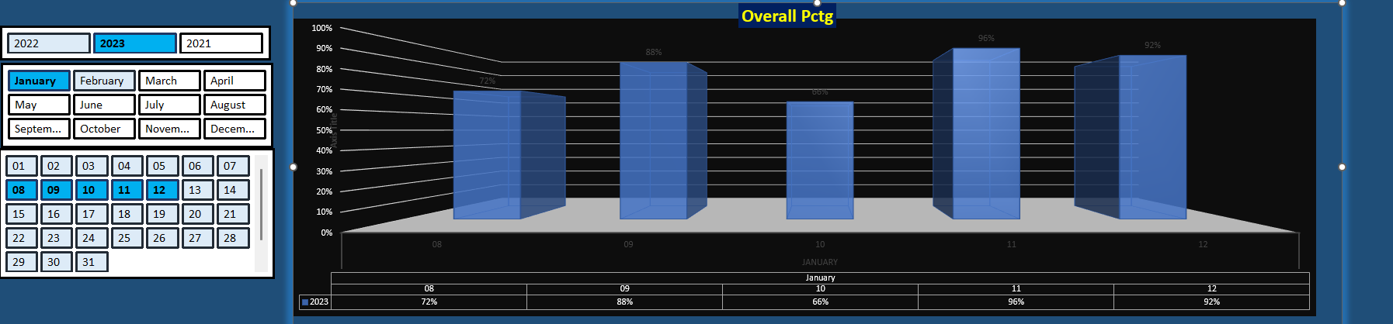
Daily Tracking in Chart Format
In Excel: Interactive Daily Tracker

Slide 20
Digital Life Span
Broken Down by years and weeks and from you DOB shows your age, how many weeks have gone by based on your DOB and Today’s date. Also, calculates how many more weeks you have left until you reach age 85
Example: Based on 5-year-old born Sept 17, 2017
Each blue square is 1 week of Life

Slide 21
Extras:
Workbook can be used for Morning Habits and Work:
Tracking Habits will help in trending habit days and keeps one on track.
If you miss a day, its okay and make the next day the starting point like everyone does on New Years Day.
No quick fix but by working on Elf Morning habits, one can live 10 to 15 years longer.

Slide 22
Conclusion: Elf Morning Tracker
Mainly, the Elf Morning tracker workbook just shows individuals how much real time left on this rock (earth) and after they enter their birthday into yellow box and that each blue square is a week (automatic updates as time goes by) that goes by pretty quickly that after age 40 even years go by almost just as quick and individuals should do daily exercises both their physical and mental exercises to make sure they are at their best until age 85 (average age for people to go into nursing homes or start to go downhill fast).
You could live longer and that’s all great but 85 is just a milestone! Yes, we have a few older folks that have sharp minds and live to be 100 but without daily practice (physical and mental) but the odds are very low that it will happen to an average older individual and that both mental and physical exercises are helpful keys. Bob Hope (lived to 100) and Ronald Reagan (lived to 93) both lived long but each had major dementia for 10-20 years at the end of their lives. Bruce Willis could live another 15 - 20 years with his current dementia diagnosis. So everyone should start mental and physical Morning exercises today, due to we don’t know what tomorrow may bring upon us. The first two Excel tabs (sheets) just explain how little time we have and the rest shows how to daily track one’s early morning rises (my time) with daily practice and if you miss a few days, not to beat yourself up but to keep going.
The exceptions to the rule are with people that are serious drug users or alcoholics and people with diabetes and certain cancers that can shorten lifespans between 23 and 28 years, so their best years of their lives go from up to 85 to 61-65 years or even shorter.
Famous People Died Early (drug or alcohol): https://www.drugs.com/celebrity_deaths.html
Read the Elf Morning book to help guide you and keep your daily habits to yourself and track them for the rest of your life. Keeping both physical and mentally strong habits will help in promoting your life and wellbeing. If you miss a few days or a week, try and get back into the daily routine!

